Slide 1
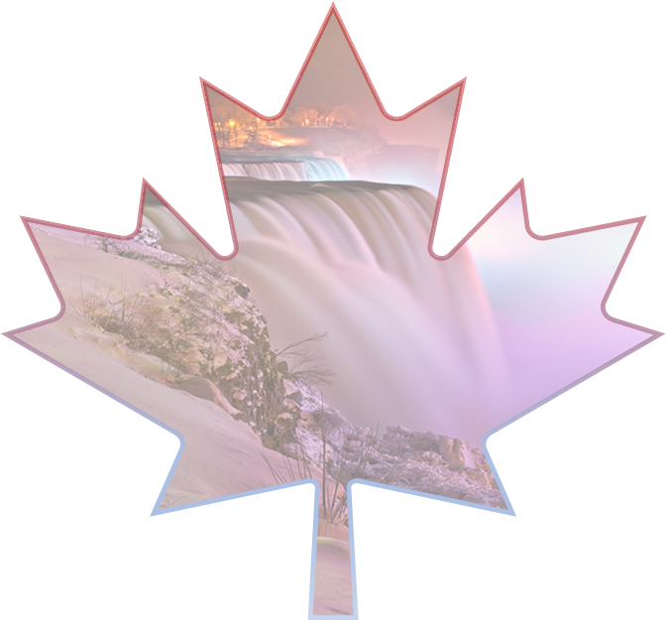
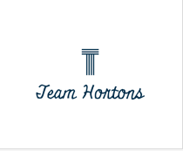
Vinay Lalwani
Navdeep Singh
Apurva Punyala
Bhavana Kaushik

Slide 2
Executive Summary
Issues
Traveller perceptions
Covid regulations
Consolidation
Objective
How can technology be integrated in the tourism industry to boost the inflow of domestic and international travellers?
Strategy
Introducing Three-step MPS strategy
Impact
Reduction of travel anxiety due to COVID in travellers. | Easier access to tourism in Canada | Less human errors and increase efficiency of the tourism industry

Slide 3
Overview
CONTRIBUTION OF TRAVEL AND TOURISM TO GDP IN CANADA
139bn CAD
CONTRIBUTION OF TRAVEL AND TOURISM TO EMPLOYMENT IN CANADA
1.59bn jobs
1ST LEADING SOURCE FOR INTERNATIONAL TOURISTS TO CANADA
UNITED STATES

Slide 4
S
W
O
T
STRENGTHS
WEAKNESSES
OPPORTUNITIES
THREATS
A lot of preset attractions already existing
Weather/ Climate (seasonal tourism)
Willingness to invest in long term tech / less travel now due to covid allows time to install these techs
Other countries offering incentives

Slide 5
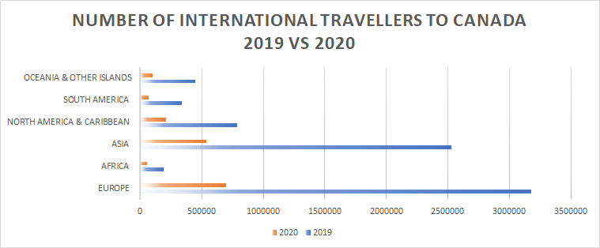
Analysis

Slide 6

Marketing
How to best advertise travel and tourism in Canada, providing incentives and removing fear of travel to facilitate increase in the industry.

Slide 7

Marketing
Promotion
How to best advertise travel and tourism in Canada, providing incentives and removing fear of travel to facilitate increase in the industry.
How to best steer tourism traffic towards Canada and allow for people to know how to best be safe and have fun in Canada.

Slide 8
Marketing
Promotion
Sustenance
How to best advertise travel and tourism in Canada, providing incentives and removing fear of travel to facilitate increase in the industry.
How to best steer tourism traffic towards Canada and allow for people to know how to best be safe and have fun in Canada.
How to best keep up with the new influx of tourist and make sure the new technology can handle the new load pushed onto the industry.

Slide 9
STEP 1: Marketing
Main focus for short term is advertising. Covid checks
Use Advanced Analytics to get to know your audience
Use data from apps to know about the audience personally, more than just demographics
Use the data to know how to get to the audience
Use data to help travellers plan so they stay longer
Make varied plans on advertising to these audiences
A more paranoid audience -> doctors
A more travel enthusiast audience -> Incentives
A more youthful audience -> Celebrities and social influencers

Slide 10

Coronaphobia:
Fear vs Facts

Slide 11
STEP 2: Promotion
Proposing a mobile application
Focuses on current excessive use of technology
Features include
Map feature
Hotel and tourist deals
Ability to book hotels in collaboration with local travel search engines
Social feature to share photos

Slide 12
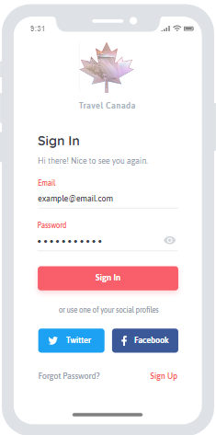
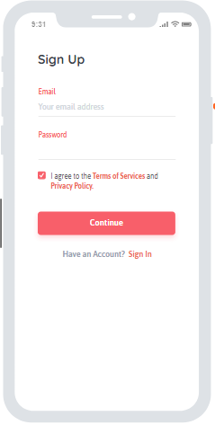
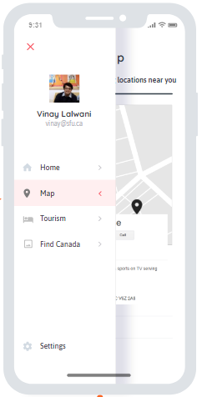

Slide 13
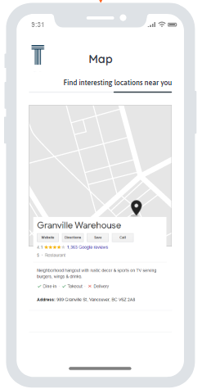
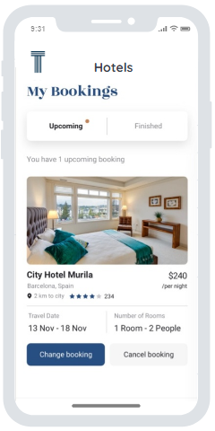
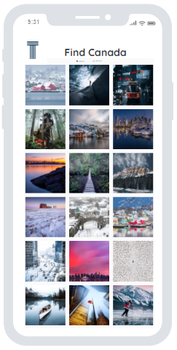

Slide 14
STEP 3: Sustenance
Influx of travellers expected
Make use of Robotic Process Automation
Allows for automation of data entry tasks
Removes chance of human errors
Automation allows for industry to handle more populous influx
Check-in using the App proposed can tackle Queuing issues
Kiosks can provide with keys for guest check-ins
No human interaction needed
Can also work with Airport Queuing issues

Slide 15
Timeline
NOW
Market Research
September 2021
Implement the app through a pilot program
June 2021
Advertising and Removing fear of Covid in travellers
3 years from now
July 2022
Ability to maintain the new influx of travel
Return to pre-COVID

Slide 16
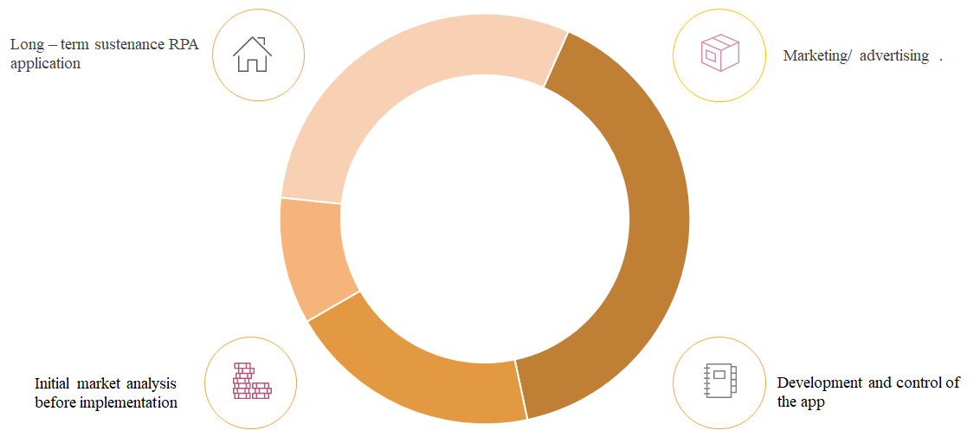
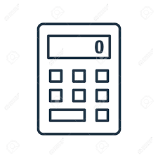
Budget

Slide 17
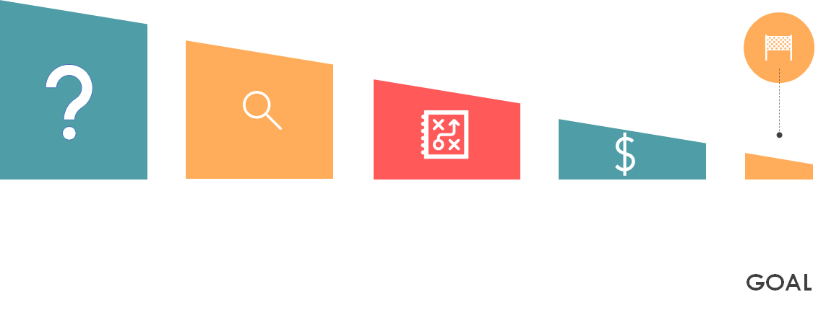
Conclusion
What problems exist? How will the industry cope up with post COVID regulations?
Travel Anxiety, Lack of Incentives, Interest in using new technology
Three step plan. Marketing
Promotion
Sustenance
Fiances and feasibility

Slide 18
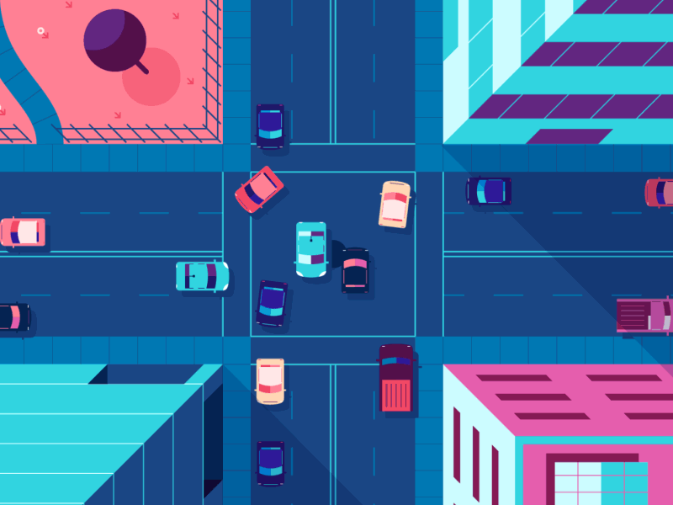
References
Business of apps. (2021). How much app developement cost. Retrieved from https://www.businessofapps.com/app-developers/research/app-development-cost/
Buxton. (n.d.). 3 Reasons to Consider a Tourism Analysis. Retrieved from https://www.buxtonco.com/blog/3-reasons-to-consider-a-tourism-analysis
Canada, D. (n.d.). 2019 Tourism fact sheet.
Canada, S. (n.d.). Non-resident travellers entering Canada, by country of residence, seasonally adjusted. Retrieved from https://www150.statcan.gc.ca/t1/tbl1/en/tv.action?pid=2410000601&pickMembers%5B0%5D=1.1&cubeTimeFrame.startMonth=01&cubeTimeFrame.startYear=2018&cubeTimeFrame
.endMonth=11&cubeTimeFrame.e
Destination Canada. (2017). Breaking through .
Infosys. (n.d.). Role of AI in travel and hospitality industry .
MLSDev. (n.d.). App Development Cost: Understand Your Budget To Build Powerful Apps.
OECD Tourism Trends and Policies 2020. (n.d.). Canada -. Retrieved from tourism in the economy : https://www.oecd-ilibrary.org/sites/2e3a791a-en/index.html?itemId=/content/component/2e3a791a-en
Path, U. (n.d.). Robotic Process Automation (RPA). Retrieved from https://www.uipath.com/rpa/robotic-process-automation
Psychiatr, A. J. (2020). Public Health Emergency COVID-19 Initiative. Retrieved from Understanding coronaphobia: https://www.ncbi.nlm.nih.gov/pmc/articles/PMC7474809/
RPA In 5 Minutes | What Is RPA - Robotic Process Automation? | RPA Explained | Simplilearn (2020). [Motion Picture].
VIDAL, B. (2019). The New Technology and Travel Revolution. Retrieved from wearemarketing: https://www.wearemarketing.com/blog/tourism-and-technology-how-tech-is-revolutionizing-travel.html

Slide 19
THANK YOU

